Slide 1

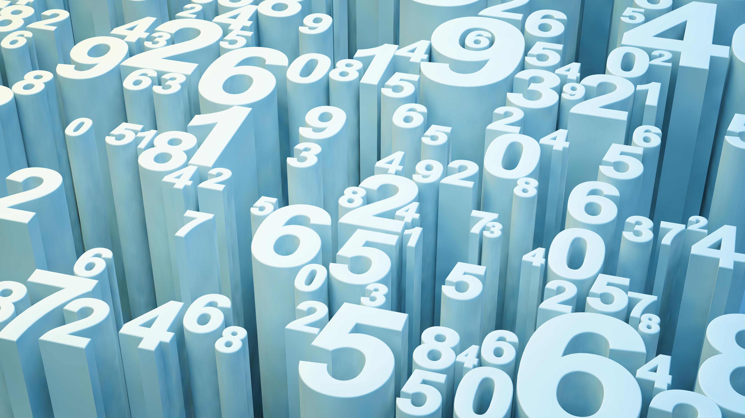
The Danger of Data Science with out Financial Theory
..the danger of not knowing what you are doing…

Slide 2


About Me
Siraprapa Watakit (Ju)
Full-Stack Developer, Corporate Trainer, Guest Lecturer, Quantitative Researcher,
PADI.Adv Diver, Aspiring Comedian!
MIF#10 (IVaR, Insider-Trading,..?)
Senior Data Scientist
Insurance Industry
Centre of Expertise
Home-Based: Hong Kong
Project-Based: Asia
Language 2.1:
English, Thai, broken Mandarin/Cantonese..

Slide 3


What is Data Science
Credit: https://datawow.io/blogs/the-three-cores-of-data-science

Slide 4

What Does a Data Scientist Do
$$y=a_{1}x_{1}+a_{2}x_{2}+b$$
Business Problem
articulate solutions to multiple stake holders
Data
Collect and Prepare
Build ML Model
Supervised or Unsupervised
Decision Making
Deep Leaning/AI,
OCR/NLP
Descriptive Analysis
Structured or Unstructured
Make informed decisions
Notes:
Take a credit scoring model as an example
X1 could be Age
X2 could be Gender
Y is credit score
a1,a2,b is what we called weight, coefficient, loading factor – these are estimated from the DATA

Slide 5
Seems straight forward, isn’t it? What could have gone wrong?
..Let’s see what have gone wrong, so far…

Slide 6
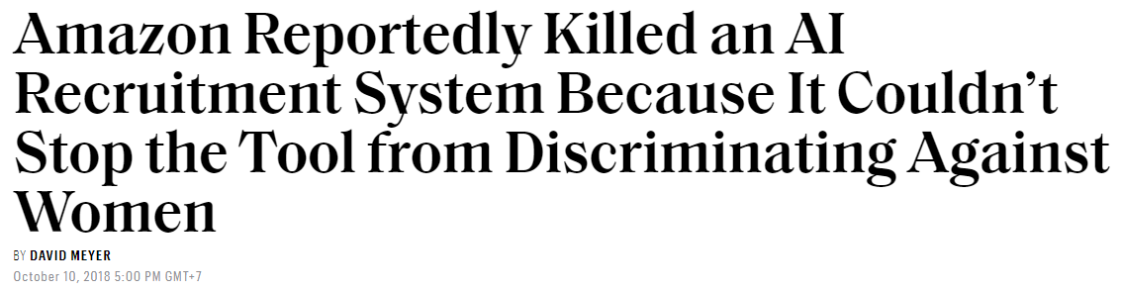
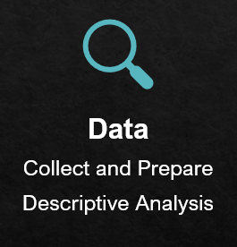
“Sexist” Model
How could this have happened?
Notes:
Sexism is prejudice or discrimination based on a person's sex or gender. Typically, against woman.
This is the classic example of imbalanced classes problem. Imbalanced classes are a common problem in machine learning classification where there is a disproportionate ratio of observations in each class.
In this case, it is obviously the majority gender class is MALE, and the minority class is FEMALE. As such, the machine learning model, especially neural net and deep learning model will tend to be biased toward the major class. That is, if you are a male, you tend to get more favorable score than female. It was never disclosed to public how much weight or loading factor has been assigned to GENDER variable, but can you imagine, hypothetically, a loading factor of 2 for MALE vs. a loading factor 0.5 for FEMALE. How is this NOT gender discrimination? How would any woman not be offended by such sexist model?
I should also note that, if we take into the account of civil history, women only get the rights to vote, the right to drive a car in late ’19 century. Even though there have been more women in the workforce since early 2000, in technology and engineering segment, it is still a very much MALE domineering world.

Slide 7
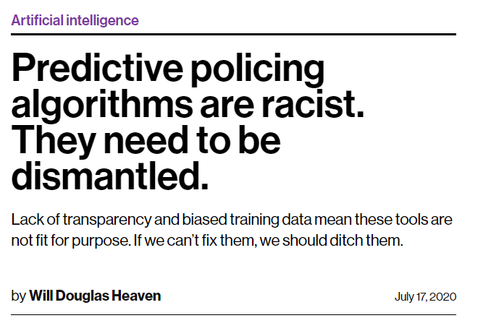
“Racist” Model
How could this have happened?
Notes:
Predictive policing uses data on the times, locations and nature of past crimes, to predict where, and at what times a crime may take place. This helps polices strategize their limited resources and personnel to patrol at specific place and time, in order to prevent future crimes. Like any algorithm, it used historical crime reports train the model
Sounds good, isn’t it? You can prevent a crime before it even happens. This exact replicate of Minority Reports, a film starring Tom Cruse in 2002.
The earlier model was used to predict WHERE the crime will take place, but the later model started to predict WHO will likely to commit the crime
The problems arise when the training dataset are severely biased against young, male, black, African American. The majority class of RACE in the training dataset is BLACK. That means, only because you are a young, male, black, African American, you are already perceived as a threat, by the model
Predictive algorithm is also used in criminal justice system, meaning if you get arrested at all, your chances of getting bail are also subjected to several other mathematical models.
It is hard to say that this is NOT a racial biased mode.

Slide 8
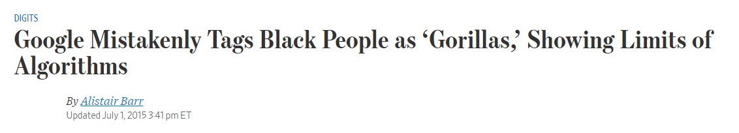

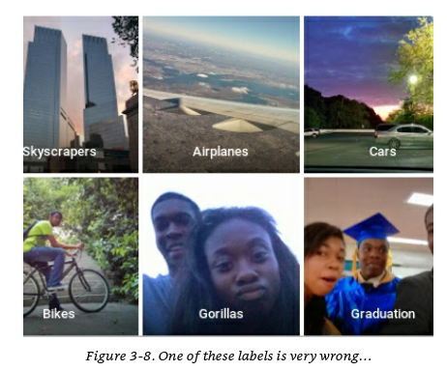
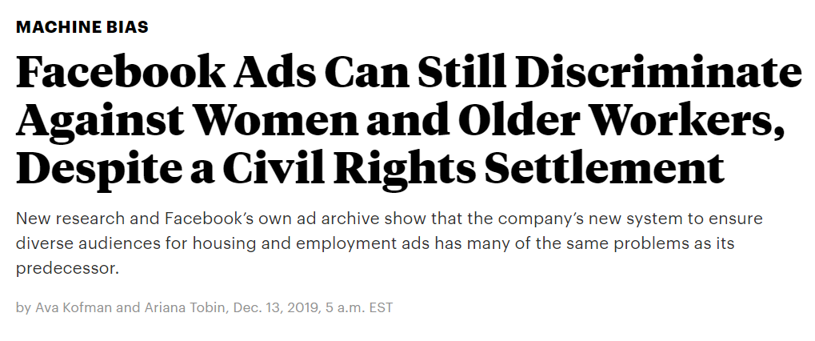
“Sexist, Racist, and Ageism” Model
It just keeps coming.., and more sobering..
Notes:
As asked by a Senator in 2018 – How do you sustain your business model when your users don’t pay for your services?...Mark smirked and answered “Senator, we run Ads.” And that it exactly what he did..
It is no secret that FB collects your personal data, feed it to the recommendation engine and flood your feeds with what it thinks you will like and click – based on your profile, age, gender, race, location and other media content that you uploaded.
FB uses the targeting ads strategy, meaning if you are of certain age, gender and race, you will see, or not seeing at all, a certain jobs ad, or housing loans offering. It is already unlawful to discriminant opportunities based on age, gender and race – Who is Facebook to deny you a chance of getting rewarding career, a house, or a much-needed job during this pandemic?

Slide 9

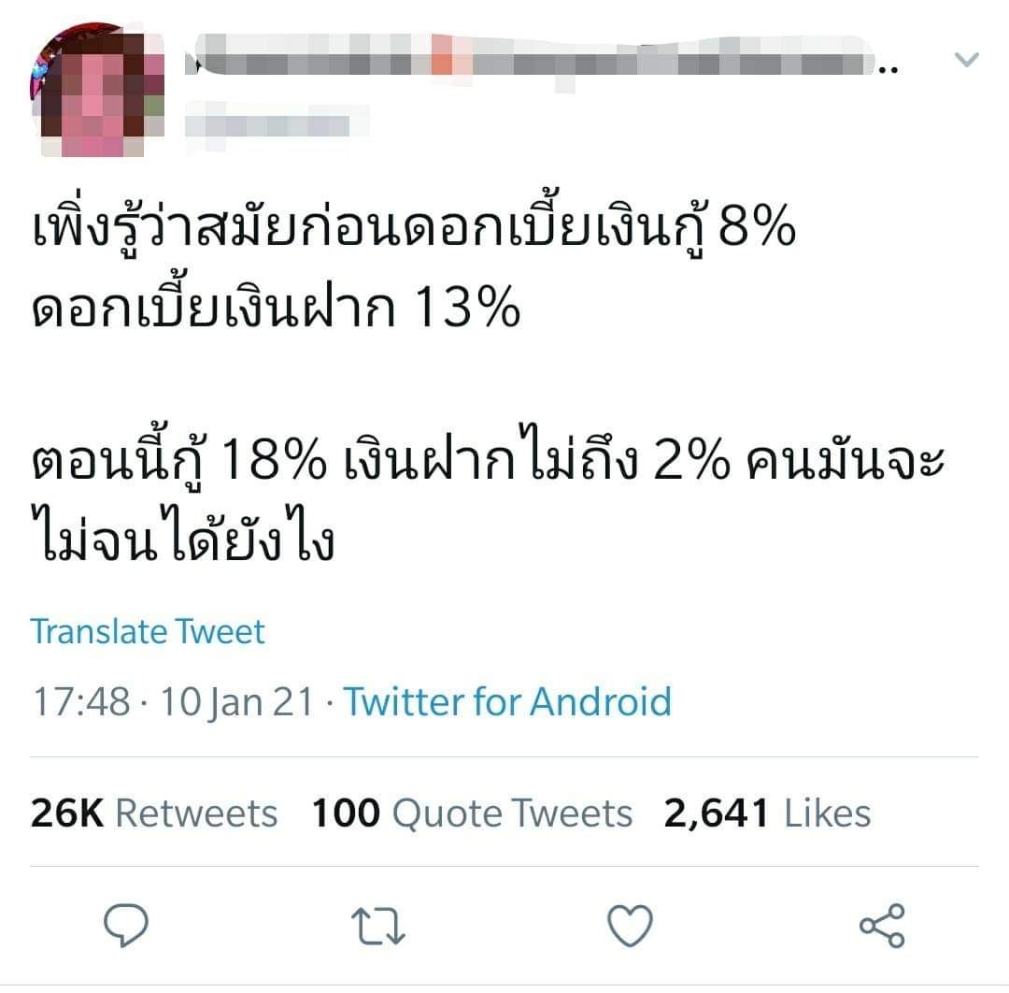
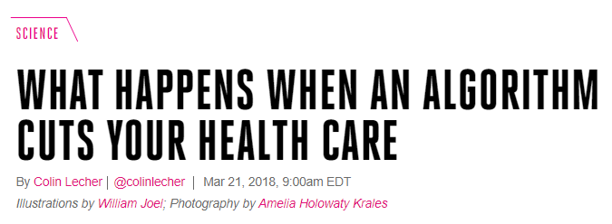
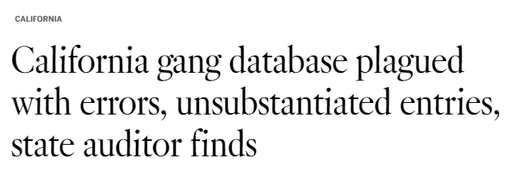
..and more..
Bank making -5% loss?? Be Critique!!
No one takes responsibility, no recourse for Tammy Dobbs
42 Babies <1y, entered DB
Not to mention misinformation, fake data, propaganda, noises, and BOTs
Notes:
Cerebral palsy
Her illness left her in a wheelchair and her hands stiffened. The most basic tasks of life — getting out of bed, going to the bathroom, bathing — required assistance. She enrolled in a state program which provide her with 56 hrs of caregiver per week.

Slide 10
How would you feel if you discovered that you were a part of a system that ended up hurting the society?
..Would you even know?.. …How could you help make sure it doesn’t happen?...
Notes:
So, now what? Why do I show you this..?
Well…I have discussed those slides with you, and know you know it
So, my question is..

Slide 11
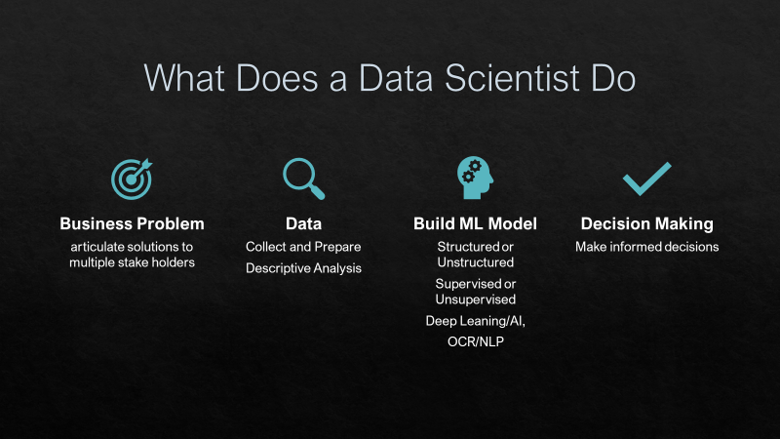
It’s not just about Data or ML Model
Ethics for Data Science
Civic Responsibility & misinformation
Work & Labor
Data Privacy &
Surveillance
Inequality, Justice & Human Rights
Laws & Policy
Regulator & Policy Maker
Social and Environmental Impact
AI, Algorithm & Feedback

Slide 12
That’s why we need framework
Business Problem
articulate solutions to multiple stake holders
Data
Collect and Prepare
Build ML Model
Supervised or Unsupervised
Decision Making
Deep Leaning/AI,
OCR/NLP
Descriptive Analysis
Structured or Unstructured
Make informed decisions
Why those data, Why those model?
Notes:
As a requirement for your graduation, you need to have a research – an Independent Study, or as we called it “IS”, or you can do Thesis too, if you choose to do so.
What you see here is exactly what you have to do, find the research topic, read lots and lots of literatures, gather data, clean data, build model, run regression or whatever – and conclude your findings.
And who know, your paper might get published, and someone might pick it up, replicate it or MAKE DECSION based on your findings.
As such, you need to be realistic, you needed to be grounded, you need an anchor to ensure that you are still “On Point”, and not getting lost into the sea of big data and fancy super powerful AI model
That is never a point, huge data and fancy model is NEVER the point of doing a research – it’s the impact that matters, you will be surprise as to how simple linear regression can outperform random forest or deep learning model.

Slide 13
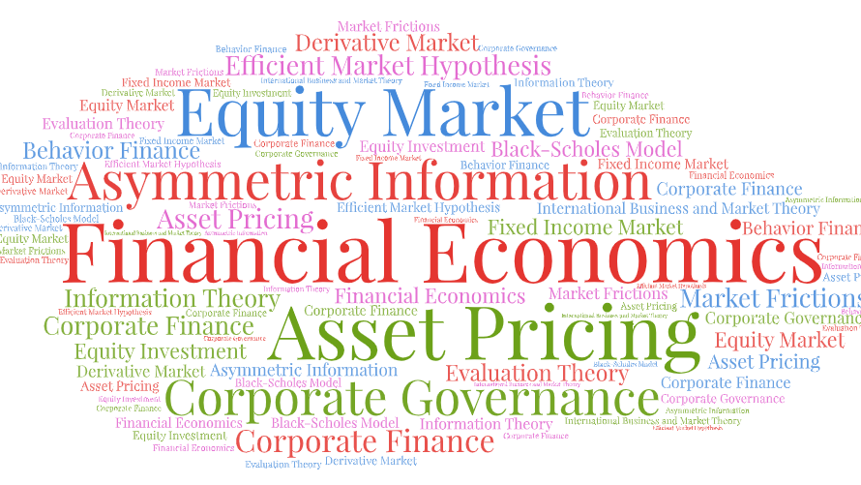
That’s why we need Financial Theory
Notes:
So, what are the framework are we talking about here..
Well, there are just so many of them, and you will get to know them, not all – but a lot.

Slide 14
How to be successful in the program/career
Academics can help you with
20%
Financial theory, mathematics, statistics, research methodology,
Programming for Financial Research – SAS/MatLab/STATA
But you are on your own with
Advanced Data Science Topics
Big Data, Rigorous data cleansing..
Python/R Programming
Machine Learning: Decision Tree, Random Forest , XGBoost, Ensemble, etc.
Deep Learning/AI: ANN, NLP, CNN, RNN, etc.
BI Tools: PowerBI, Tableau, QlikSense, QlikView, etc.
80%
Grits
Critical Mindset
Everything else..
Growth Mindset

Slide 15
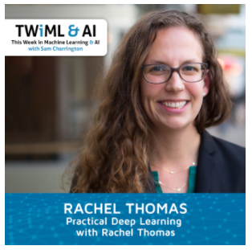
Thank you for your Attention
Data are not bricks to be stacked,
Oil to be drilled,
Gold to be mined
Opportunities to be harvested
Data are humans to be seen,
Maybe loved,
Hopefully taken care of
-- Inioluwa Deborah Raji, AI Research Google Inc.
USF, Co-Founder of Fast.AI

